Slide 1
Welcome to the RA SAS Chain of Custody course
Case study module
Date | Location | Details

Slide 2
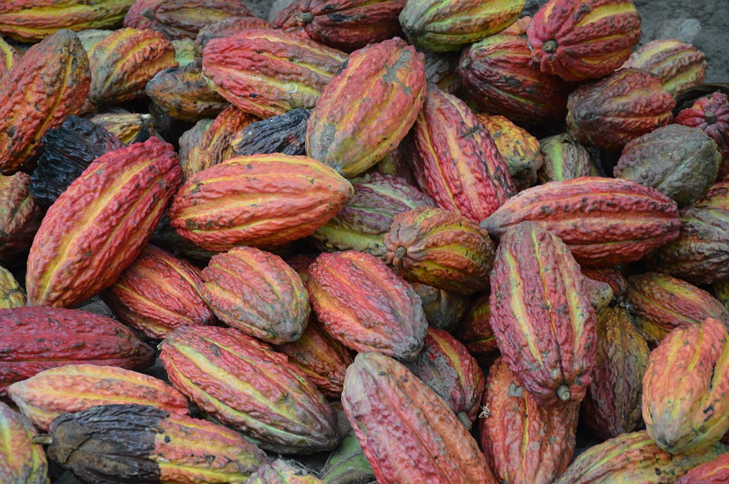
Case study 1
Multi-site Operator – Cocoa Production and Marketing
Notes:
Ultimate purpose of CoC standard is to ensure integrity and traceability of certified product. Both issues are priorities and their requirements are established in Principle 2.
Rainforest Alliance registered trademarks can be used on products from certified farms. The criteria related to this topic are given in Principle 3.

Slide 3
Case study 1 – Total Cacao
Total Cacao is a manufacturer and marketer of cocoa products, based in Zurich, Switzerland, which consists of 12 entities ranging from cocoa production to the marketing of finished chocolate products.
The company is a global multi-site operation that incorporates all the different stages of the supply chain (production, sale and purchase, storage, reception, processing, blending, packaging, shipping and transportation). It also distributes its products to local and international markets and is responsible for financing all its multi-site operations.
Notes:
Ultimate purpose of CoC standard is to ensure integrity and traceability of certified product. Both issues are priorities and their requirements are established in Principle 2.
Rainforest Alliance registered trademarks can be used on products from certified farms. The criteria related to this topic are given in Principle 3.

Slide 4
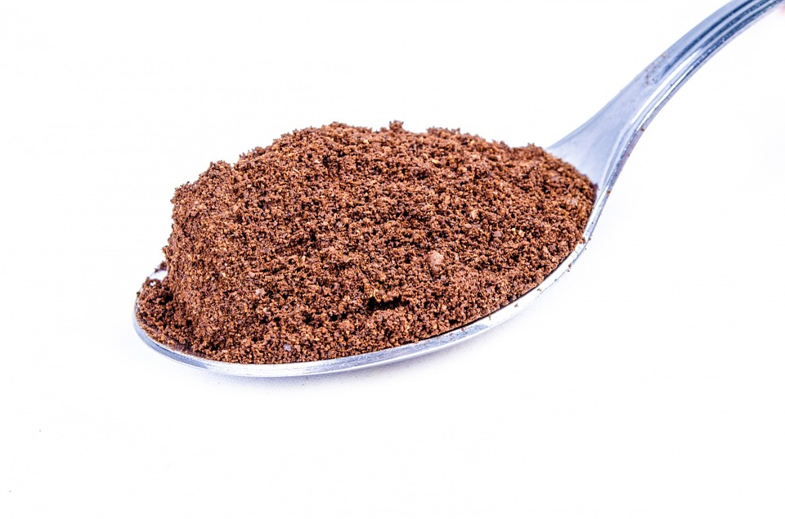
Case study 1 – Total Cacao
The companies that make up Total Cacao are, cacao bean producers, exporters, importers, manufacturers.
In cacao production
COOPP : This company has several certified cooperatives to which it gives support with technical assistance and RAC certification. The cooperatives are controlled by this company and are located in Ivory Coast.
Notes:
Ultimate purpose of CoC standard is to ensure integrity and traceability of certified product. Both issues are priorities and their requirements are established in Principle 2.
Rainforest Alliance registered trademarks can be used on products from certified farms. The criteria related to this topic are given in Principle 3.

Slide 5
Case study 1 – Total Cacao
B) In Exports: Total Cacao receives cocoa beans from several countries, including Ivory Coast, through its local exporters, as well as from other countries such as Ghana, Tanzania and Ecuador.
Local and multinational exporters | Product country of origin
Local exporter 1 | Ivory Coast
Multinational exporter affiliate 2 | Ghana
Multinational exporter affiliate 3 | Tanzania
Multinational exporter affiliate 4 | Ecuador
Notes:
Ultimate purpose of CoC standard is to ensure integrity and traceability of certified product. Both issues are priorities and their requirements are established in Principle 2.
Rainforest Alliance registered trademarks can be used on products from certified farms. The criteria related to this topic are given in Principle 3.

Slide 6
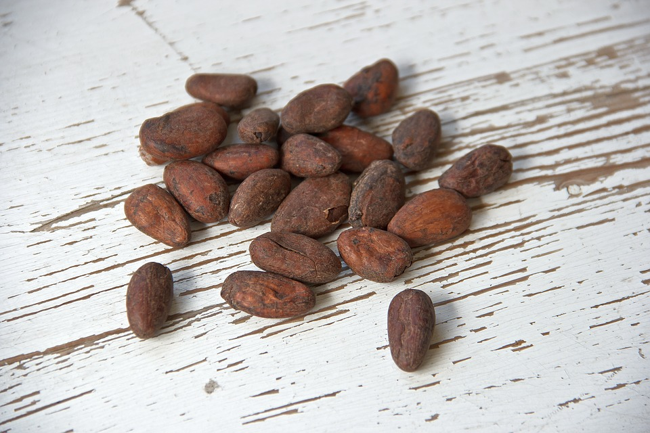
Case study 1 – Total Cacao
C) In Imports: All cocoa beans are imported through Total Cacao. This company administers all the cocoa bean purchase/sale contracts, it does not take physical possession of the product and it is the financier for all the product its sites acquire.
Notes:
Ultimate purpose of CoC standard is to ensure integrity and traceability of certified product. Both issues are priorities and their requirements are established in Principle 2.
Rainforest Alliance registered trademarks can be used on products from certified farms. The criteria related to this topic are given in Principle 3.

Slide 7

Case study 1 – Total Cacao
D) In Processing: There are several multinational processors situated in different parts of the world. These companies receive the cocoa beans and manufacture basic products, such as cocoa liquor, cocoa paste, powdered cocoa and cocoa butter. All these products are marketed as RAC.
Notes:
Ultimate purpose of CoC standard is to ensure integrity and traceability of certified product. Both issues are priorities and their requirements are established in Principle 2.
Rainforest Alliance registered trademarks can be used on products from certified farms. The criteria related to this topic are given in Principle 3.

Slide 8
Case study 1 – Total Cacao
Processing company | Activities | Client
Processing 1 – France | Powdered cocoa, cocoa butter, cocoa liquor | Manufacturing company in Belgium
 | Cocoa paste and cocoa butter | Manufacturing company in Belgium
Processor 2 – France (subcontractor) | Cocoa liquor and cocoa butter | Manufacturing company in the US. Pennsauken
Processor 3 – USA | Powdered cocoa, cocoa liquor and cocoa paste | Manufacturing company in Canada
Processor 4 - Malaysia | Cocoa liquor | Manufacturing company in Belgium
Notes:
Ultimate purpose of CoC standard is to ensure integrity and traceability of certified product. Both issues are priorities and their requirements are established in Principle 2.
Rainforest Alliance registered trademarks can be used on products from certified farms. The criteria related to this topic are given in Principle 3.

Slide 9
Case study 1 – Total Cacao
These products are used as the base for several finished products made by other manufacturing companies, whose owner is also Total Cacao. These companies package product and have received approval to use the RAC seal.
Manufacturing company using the RAC Seal | Type of finished product | Finished product destination country
Company in Belgium | Chocolate / ice cream | Netherlands, Italy, Hungary, United Kingdom and Poland
Company in Canada | Chocolate chips | USA
Notes:
Ultimate purpose of CoC standard is to ensure integrity and traceability of certified product. Both issues are priorities and their requirements are established in Principle 2.
Rainforest Alliance registered trademarks can be used on products from certified farms. The criteria related to this topic are given in Principle 3.

Slide 10

Case study 1 – Total Cacao
Total Cacao has completed and submitted 12 requests for Chain of Custody Risk Assessment (CRA) by Rainforest Alliance. Total Cacao provided the following information to the Certification Body, regarding the decision of RA:
Notes:
Ultimate purpose of CoC standard is to ensure integrity and traceability of certified product. Both issues are priorities and their requirements are established in Principle 2.
Rainforest Alliance registered trademarks can be used on products from certified farms. The criteria related to this topic are given in Principle 3.

Slide 11
Case study 1 – Total Cacao
Risk category | Company name
Very low risk | Total Cacao importer
Low risk | Multinational exporter affiliate 2 - Ghana Multinational exporter affiliate 3 – Tanzania Processor 1 – France Processor 4 – Malaysia Manufacturing company in Belgium Manufacturing company in Canada
Medium risk | Local exporter – Ivory Coast Processor 2 – France COOP – Producers
High risk | Multinational exporter affiliate 4 – Ecuador Processor 3 – USA
Notes:
Ultimate purpose of CoC standard is to ensure integrity and traceability of certified product. Both issues are priorities and their requirements are established in Principle 2.
Rainforest Alliance registered trademarks can be used on products from certified farms. The criteria related to this topic are given in Principle 3.

Slide 12
Case study 1 – Total Cacao
CONSUMERS
End markets for chocolate
End Buyer 1 Europe
End Buyer 2 USA
End Buyer 3 USA
Manufacturing
Multinational manufacturing in Belgium
Multinational manufacturing in US and Canada
Processing
Processor 1 France
Subcontracted Processor 2 France
Processor 4 Malaysia
Processor 3 USA
Marketing/ Importation
Multinational marketer/ Switzerland
Export
Local exporter in Ivory Coast
Multinational exporter affiliates
Suppliers
Certified producers in Ghana
Certified producers in Tanzania
Certified producers in Ecuador
Cocoa Beans Production
Local certified cooperatives/ Ivory Coast
Notes:
Ultimate purpose of CoC standard is to ensure integrity and traceability of certified product. Both issues are priorities and their requirements are established in Principle 2.
Rainforest Alliance registered trademarks can be used on products from certified farms. The criteria related to this topic are given in Principle 3.

Slide 13

Case study 1 – Total Cacao
Calculate sample size for number of sites and which criteria
Processor 3 – US, high risk, does not comply with RA traceability guidelines. Which documents do you request to evaluate the traceability of the product and to what do you compare them to ensure effectively that the processed product comes from certified farms?
For sites at low risk, which documents do you request to evaluate the traceability of the product in the desk audit? What other documents do you compare them with?
Processor 2 – France (subcontracted) processes products that it receives from Total Cacao and from other clients to which it applies “Mass Balance”. For its end product, Total Cacao has Option C for the use of the RAC seal approved. How do you evaluate if the product processed is 100% segregated within the plant and there is no “Mass Balance”?
Questions

Slide 14
Case study 1 – Total Cacao - Questions
Calculate sample size for number of sites and which criteria.
Processor 3 – US, high risk, does not comply with RA traceability guidelines. Which documents do you request to evaluate the traceability of the product and to what do you compare them to ensure effectively that the processed product comes from certified farms?
For sites at low risk, which documents do you request to evaluate the traceability of the product in the desk audit? What other documents do you compare them with?
Processor 2 – France (subcontracted) processes products that it receives from Total Cacao and from other clients to which it applies “Mass Balance”. For its end product, Total Cacao has Option C for the use of the RAC seal approved. How do you evaluate if the product processed is 100% segregated within the plant and there is no “Mass Balance”?

Slide 15
Case study 1 – Total Cacao – Questions
The manufacturing company in Belgium was categorized as low risk in its CRA. But the auditor confirms that there are sufficient elements to suggest it be placed at a high category of risk. What information should be reported to back up this situation?
Can Total Cacao receive a global multi-site certificate that covers all the sites included in its scope?

Slide 16

Case study 1 – Total Cacao
Answers

Slide 17
Case study 1 – Total Cacao – Answers
For the total of 11 sites, the square root is 3.32, which we round up to 4. The first criterion to use to determine the composition of the sample, is that it is representing the levels of risk; for this you should audit at least one site at the low level, one at the medium level and one at the high level. Since you still need to include a fourth site, you can use the criterion of giving more priority to those at higher risk, therefore you should evaluate two sites at the high level. You need to then use the geographic criterion, so you could evaluate, for example, one site at the low level in Tanzania and one at the medium level in France. Finally, for the two sites at high risk you could evaluate the one in Ecuador and the one in Zurich.
You need to evaluate their validations (TCs). You should be able to do a “traceback audit” to determine if indeed the product comes from certified farms. In order to make comparisons you must request the purchasing contracts, Bills of Lading (B/L), and the certificates that indicate the product meets the RA Standard.

Slide 18
Case study 1 – Total Cacao – Answers
Validations and purchasing documents such as contracts, B/Ls.
For compliance, you should evaluate how product segregation is done, checking the transaction certificates (TCs) and tracking the product contained in the final package to verify its complete traceability, investigating the purchase receipts, purchasing contracts, storage and processing to evaluate that the percent of certified product is effectively met.
Among the possible causes, you could indicate the fact that the country’s corruption perception index has deteriorated, or that the company has lost another certification or that there are complaints about the company, specifically related to the integrity of the products it handles.
Yes, because all the sites are part of the same company (or consortium of companies, to be more specific).

Slide 19

Case study 2
Orange Group – Processing and marketing of orange juice
Notes:
Ultimate purpose of CoC standard is to ensure integrity and traceability of certified product. Both issues are priorities and their requirements are established in Principle 2.
Rainforest Alliance registered trademarks can be used on products from certified farms. The criteria related to this topic are given in Principle 3.

Slide 20
Case study 2 – Orange Group
Orange Group carries out its activities in all sectors of citriculture. It develops orange processing activities and exports / imports orange juice concentrate (OJC). It consists of three fruit processing plants, a port terminal in the country of origin (export) and a port terminal in Europe (import).
Orange Group receive oranges from a group of five farms with RAC certification, whose estimated production for the harvest this year is 600,000 tons of oranges. Each one of the five farms has the capacity to harvest and deliver to the processing plants around 500 tons of oranges per day.
The main plant (central office) has a production capacity of 8,000 tons of oranges per day, divided between its two production lines (4,000 tons per line).

Slide 21
Case study 2 – Orange Group
The plant also receives fruit not certified by RAS and in its system, the exclusive processing of fruit from certified farms (100% RAC OJC) is not possible due to the scheduling of orange reception from the suppliers and the delivery of OJC to the buyers. A second plant, around 100 km away from the central office, is defined as an alternative OJC processing site. Its production capacity is lower than that of the main plant (3,000 tons of fruit per day), but it uses the same processing system.
European buyers of certified OJC require a minimum concentration of 70% certified orange juice in the final juice concentrate volume, in other words, RAC OJC ≥ 70%. The determination of the minimum concentration that the buyers want coincides with the rules for the approval and use of the RAC seal. The juice processing plants use 10,000 tons of oranges on average to produce 10 tons of OJC, therefore each ton of OJC requires 1,000 tons of oranges. Orange processing to obtain OJC has the following steps: Fruit reception, fruit cleansing, juice extraction, primary filtration, secondary filtration, centrifuging, concentration/pasteurization, pre-cooling, final cooling, bulk storage, bulk cargo and reprocessing.

Slide 22
Case study 2 – Orange Group
In the plant receiving area, certified fruits are weighted, analysed and stored in exclusive silos known as “bins”, from the previously cleaned unloading ramps. The fruits can be sent to the two production lines on canvas mats, according to production order.
Certified orange processing is done in one production line only (4,000 tons). For this, the line passes through conditioning to get it ready before processing (cleansing with certified OJC and subsequent disposal of the product per RAC) or the residual juice in the line is considered in the conversion factor for the determination of the certified OJC concentration, where the size of the pipes, or the processing time for each stage and all possible means of entry are known and necessary for the calculation of the certified OJC concentration.

Slide 23
Case study 2 – Orange Group
After the oranges are washed, they are sent to the extraction rooms. Each production line has its own extraction machines, where juice extracted during the process is non-miscible. From the extraction area, the production lines can receive extracted juice from both extraction rooms; however, this only occurs when there is production of “low pulp” orange juice in one of the lines to produce an intentional blend. In this case, the non-certified juice (“low pulp”) is considered in the determination of the final certified OJC concentration.
The formation of the certified juice batch is done based on the processing capacity of the blending tank (600-ton Tank Blender). The orange juice being processed continues along the production line to the Tank Blender, where it is given a batch code and the final juice concentration is determined. The product is then sent to the Tank Farm for storage. According to the concentration of orange juice (OJC) achieved and the concentration desired by the European buyers, the product may again be sent to the Tank Blender for a new code and new concentration determination, in this case generating a new batch.

Slide 24
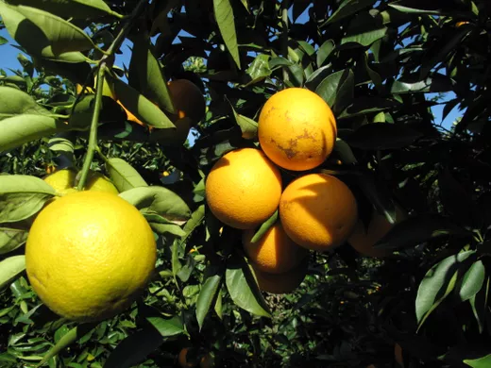
Case study 2 – Orange Group
After receiving and storing the OJC at the Group Orange terminal, the product undergoes filtration to remove any possible impurities and it is then ready to be loaded into tankers for transportation to the buyer. The transfer of the product is
Done with the tax documents and the proper statements of RAS certification and qualification for the OJC (% RAC).

Slide 25
Case study 2 – Orange Group
Questions
Calculate sample size for number of sites and which criteria
Processor 3 – US, high risk, does not comply with RA traceability guidelines. Which documents do you request to evaluate the traceability of the product and to what do you compare them to ensure effectively that the processed product comes from certified farms?
For sites at low risk, which documents do you request to evaluate the traceability of the product in the desk audit? What other documents do you compare them with?
Processor 2 – France (subcontracted) processes products that it receives from Total Cacao and from other clients to which it applies “Mass Balance”. For its end product, Total Cacao has Option C for the use of the RAC seal approved. How do you evaluate if the product processed is 100% segregated within the plant and there is no “Mass Balance”?

Slide 26
Case study 2 – Orange Group - Questions
Definition of the scope of the certification and planning the audit.
What kinds of chain of custody operators are identified and what does each one have to do to have RA CoC authorization?
How is the sample size for the audit determined and which criteria affect the sampling?
Prepare the Audit Plan for the Orange Group certification process defined earlier, considering the composition of the auditor team (technical responsibilities), auditing time (days in the field and travel – division of labour) and the scheduling of the audit.

Slide 27
Case study 2 – Orange Group - Questions
Use and approval for the seal
How should the transfer of physical possession of the certified OJC between each site under the Orange Group CoC certification scope be recorded?
Can the Orange Group use the Rainforest Alliance Certified™ seal? In what way?
Could the Orange Group OJC buyer claim that the orange juice is certified without using a disclaimer?

Slide 28
Case study 2 – Orange Group
Answers

Slide 29
Case study 2 – Orange Group - Answers
Definition of the scope of the certification and planning the audit.
The certified group administrator and all the infrastructure under its scope should be evaluated with respect to relevant chain of custody criteria during its regular audit (certification and annual audits). Each infrastructure site outside the scope of the group administrator must submit a CRA to Rainforest Alliance and follow up with the corresponding activities (audits most likely). If there are more than two sites outside the scope of the group administrator, according to the results of the CRA, they need a CoC certificate; each site can then apply individually for certification, or they could form a multi-site operator. The transportation companies are outside the scope. In Europe, each site that processes orange juice must also submit a CRA and then meet the requirements established in the CoC policy.
If a multi-site operator is formed, you should audit the number of sites equivalent to the square root of the total number of sites. The initial sample should include the administration office that operates in one of the plants, as well as sites that are representative of the different activities carried out.

Slide 30
Case study 2 – Orange Group - answers
Audit plan: The answer remains open, but no fewer than two auditors should participate, working for at least 0.5 days. At least one of the auditors who participates in the audit of the group administrator should have considerable experience with chain of custody and, ideally, experience with the citrus and/or fruit juice extraction industry.

Slide 31
Case study 2 – Orange Group - Answers
Use and approval for the seal
There are transaction certificates for oranges, see traceability guidelines. As a cross check it would be good to submit documentation that verifies the receipt or delivery of the product, including the type of product, its volume and certificate status.
With a certified content of less than 90%, a disclaimer should be included under the seal.
No, they will need a disclaimer (declaration of content).

Slide 32
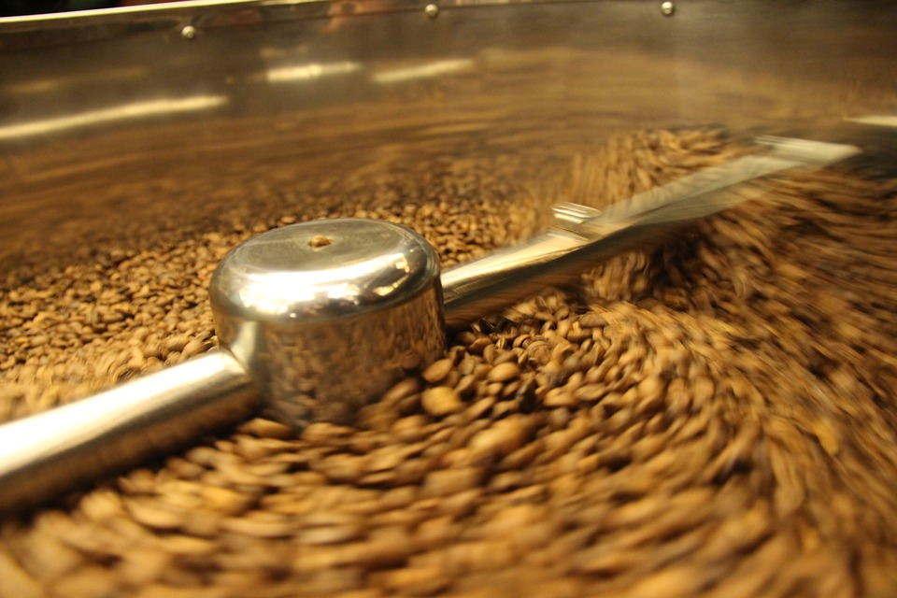
Case study 3
Coffee mill – San Cocho
Notes:
Ultimate purpose of CoC standard is to ensure integrity and traceability of certified product. Both issues are priorities and their requirements are established in Principle 2.
Rainforest Alliance registered trademarks can be used on products from certified farms. The criteria related to this topic are given in Principle 3.

Slide 33
Case study 3 – San Cocho Mill
The San Cocho Mill has been implementing the Rainforest Alliance Chain of Custody Requirements for two years. The mill processes SHG (Strictly High Grown or Strictly Hard Bean) and HG (High Grown or Hard Bean) coffee. This is produced on farms that comply with the RA SAS (known as ‘RAC coffee’) and Fair Trade (known as ‘FLO coffee’) certification schemes. The mill also processes non-certified conventional or generic coffee—including coffee from three farms that, at the time of the audit, were preparing to receive an audit based on the RA SAS standards for farms.
The auditor asked the mill manager to explain the procedures implemented for product segregation. The mill manager answered that they use different infrastructure according to the type and quality of the coffee and they place signs to identify the RAC coffee; these are some of the methods they use to ensure product integrity.

Slide 34
Case study 3 – San Cocho Mill
The auditor asked for records on incoming coffee and observed the following data:
According to the liquidation records, the total volume of coffee that came in from the farms was 426,600 kg green bean coffee, of which:
103,501.81 kg corresponds to RAC coffee;
116,681.81 kg corresponds to generic coffee, and
206,416.36 kg corresponds to certified coffee under the Fair Trade scheme.
According to the mill report, the volume of RAC coffee cherries that entered was 517,509.09 kg. The resulting volume for the process was 98,385.45 kg of green bean coffee. The milling report (dry milling) shows a volume of 85,595.45 kg of fine green bean coffee. According to data from Marketplace, three transactions were made: the first transaction with 750 bags, the second with 275 bags, and the third with 230 bags; each bag holds 69 kg.

Slide 35
Case study 3 – San Cocho Mill
The mill manager showed the records of the internal auditors, training records, and the permits required according to national law (permits from environmental, health and governmental authorities). Once conformity was found in the documents submitted, the visit to the facilities was begun.
The Mill Administrator explained that in processing coffee, batches are formed, combining coffee by the qualities that are received the same day. The auditor was struck by the comment and checked the daily records for the different control points of the mill, starting with the scale for weighing. The auditor requested the records for January 2, 2017, and found the following:

Slide 36
Case study 3 – San Cocho Mill
Farm | Quality | Type of certification | Green bean weight kg (theoretical)
El Amate | HG | RAC | 5,500.00
Veracruz | SHG | FLO | 6,022.70
El Trigal | HG | FLO | 3,909.09
El Pacayal | HG | RAC | 3,204.50
La Sonta | HG | RAC | 1,727.27
El Chaperno | SHG | RAC | 6,818.18
Los Laureles | SHG | RAC certification in process | 1,954.50
La Barranca | HG | RAC certification in process | 727.27
Buena Vista | HG | RAC certification in process | 3045.45
El Escondido | SHG | FLO | 3,272.73
Zapato de Mico | HG | RAC | 1,090.90
La Otra | SHG | RAC | 7,727.27

Slide 37
Case study 3 – San Cocho Mill
In the records for the coffee drying yard, the auditor found the following information:
The head of the warehouse provided records with the following information:
Batch no. | Mill entry date | Yard | Quality | Incoming green bean weights kg (theoretical)
143 | Jan 2, 2017 | #1 | HG | 19,204.54
144 | Jan 2, 2017 | #2 | SHG | 25,795.45
Batch | Warehouse entry date | Quality | Dry parchment weight kg (actual)
143 | Jan 11, 2017 | HG | 21,905.909
144 | Jan 11, 2017 | SHG | 29,424.090

Slide 38
Case study 3 – San Cocho Mill
And upon checking the consolidated production report, the management had the following data:
Mill entry date | Certification | Quality | Green bean kg (actual)
Jan 2, 2017 | RAC | HG | 10,952.727
Jan 2, 2017 | RAC | SHG | 13,825.909
Jan 2, 2017 | FLO | SHG | 8,835.450
Jan 2, 2017 | FLO | HG | 3,715.450
Jan 2, 2017 | RAC certification in process | HG | 3,585.909
Jan 2, 2017 | RAC certification in process | SHG | 1,857.720

Slide 39
Case study 3 – San Cocho Mill - background
The coffee goes through three stages: Cherry coffee parchment coffee green bean coffee.
For this case, the cherry: green bean ratio is 5.2 : 1
The parchment to green bean ratio is 1.2 : 1
The ‘fine green bean’ category refers to green bean coffee that meets the classification requirements.
It corresponds to 95% green bean coffee.

Slide 40
Case study 3 – San Cocho Mill
Calculate sample size for number of sites and which criteria
Processor 3 – US, high risk, does not comply with RA traceability guidelines. Which documents do you request to evaluate the traceability of the product and to what do you compare them to ensure effectively that the processed product comes from certified farms?
For sites at low risk, which documents do you request to evaluate the traceability of the product in the desk audit? What other documents do you compare them with?
Processor 2 – France (subcontracted) processes products that it receives from Total Cacao and from other clients to which it applies “Mass Balance”. For its end product, Total Cacao has Option C for the use of the RAC seal approved. How do you evaluate if the product processed is 100% segregated within the plant and there is no “Mass Balance”?
Questions

Slide 41
Case study 3 – San Cocho Mill - Questions
Based on the data provided, is the mill in conformance with requirements 2.2 and 2.4 of the RA CoC Standard? If not, describe the nonconformity, including whether it is major or minor, or if it requires an observation.
Describe other audit techniques (records, interviews, observations) that would be needed to demonstrate full compliance with all the requirements of the Principle for Traceability.
Do you believe the volume recorded in the transaction certificates exceeded the volume of coffee available or not?
Is it possible to determine whether the volume recorded for the drying yards coincides with the volume received? How?

Slide 42
Case study 3 – San Cocho Mill
Answers

Slide 43
Case study 3 – San Cocho Mill - Answers
Requirement 2.2 can be considered to have been met (visual identification). A minor nonconformity can be assigned for criterion 2.4, which asks for records on quantities of product received, product received and processed in storage, and the quantity of product sold. There appears to be sufficient information for the first two points (although it could be organized better), but data on the exact amount of product sold is lacking.
These could be sales records, interviews with personnel who receive and store the product, and observations at the reception, processing and storage areas.

Slide 44
Case study 3 – San Cocho Mill - Answers
Yes, because they had 85,595.45 kg of fine green bean coffee and the sum of the three transaction certificates is 86,595 kg (exceeding the amount by 999.55 kg).This in case that the three transaction certificates are from the same crop period, for example 2017-2018
Yes, because there is the report on the volume of coffee in the drying yards: 19,204.54 kg HG and 25,795.45 kg SHG; and there is the list of coffee delivered by the farms, by quality of coffee, which total 19,204.48 kg HG and 25,795.38 kg SHC, therefore, the difference of 0.06 and 0.07 kg respectively is insignificant).

Slide 45

Thank you

Slide 46
233 Broadway, 28th Floor New York, NY 10279
USA
De Ruyterkade 6 1013 AA, Amsterdam,
The Netherlands

